Slide 1
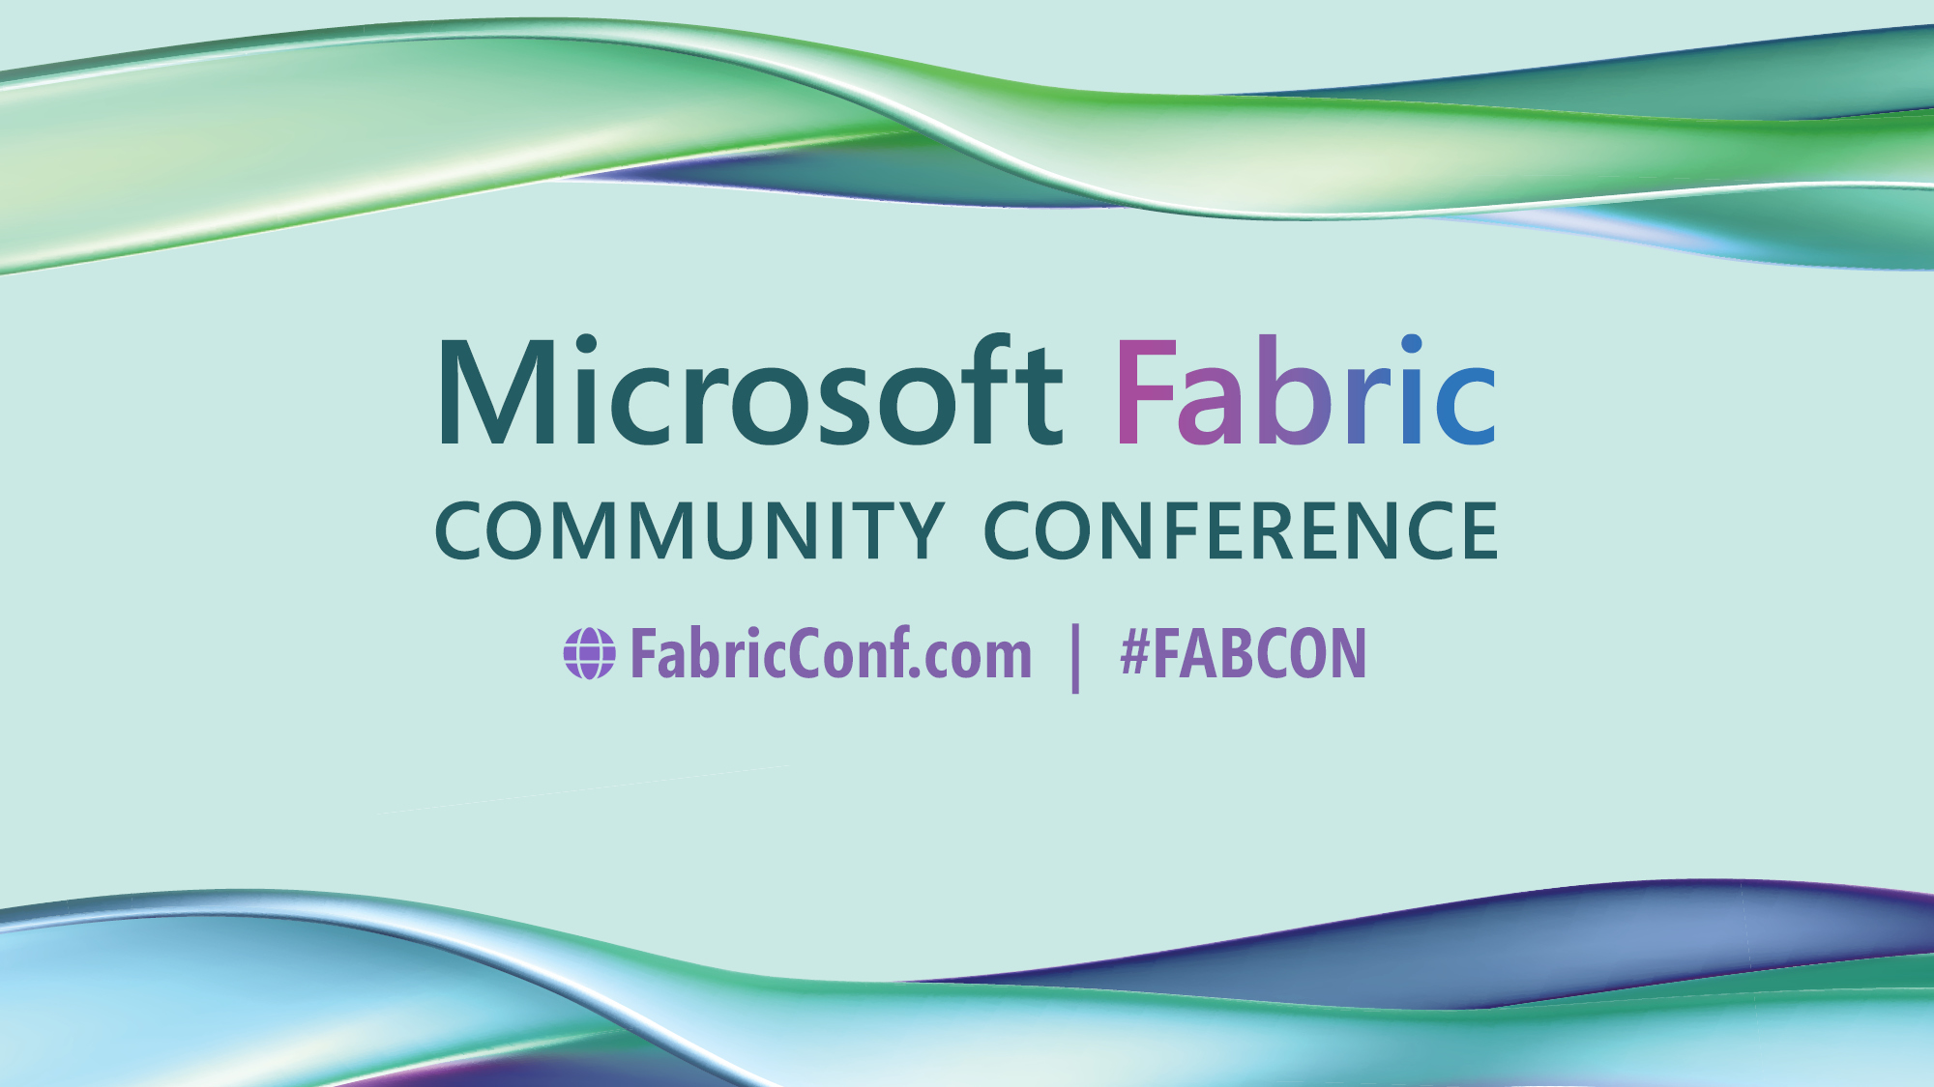

Slide 2
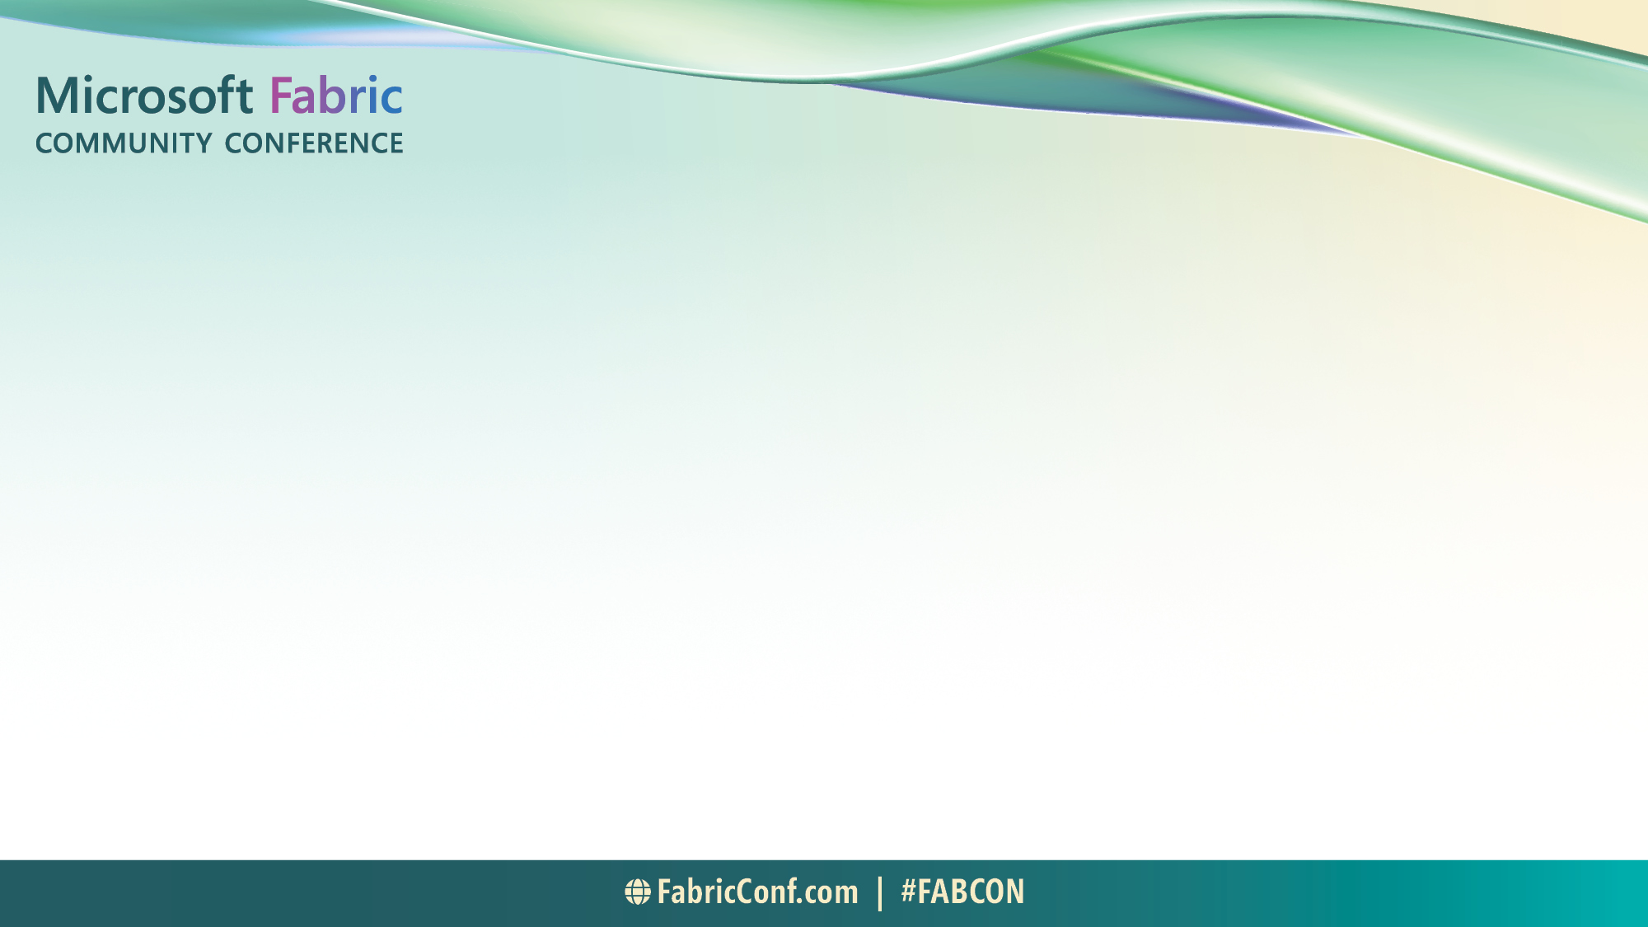
Lessons Learned While Replacing ADF and Azure SQL
Exploring strategies and challenges in data migration.

Slide 3

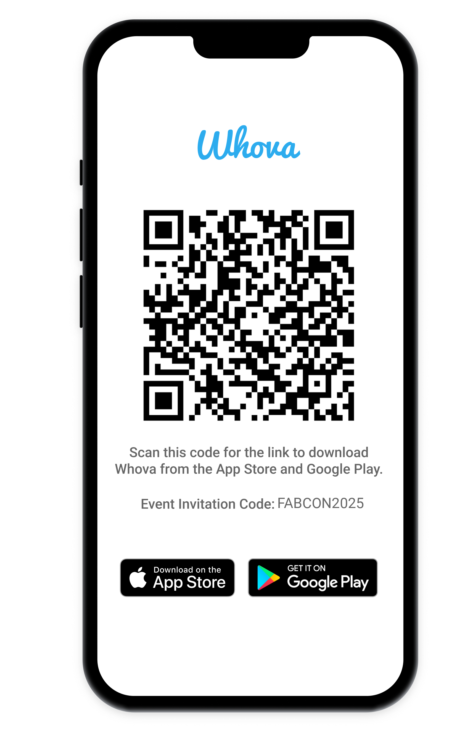
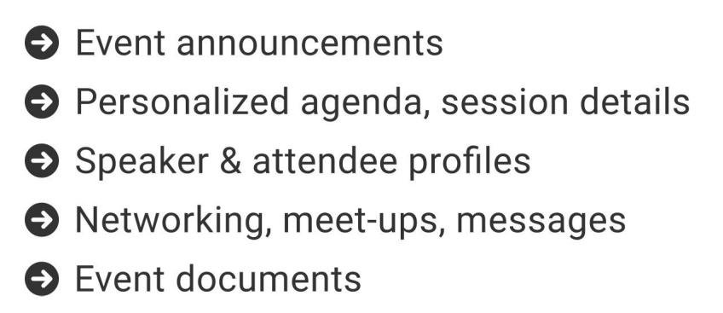
The official event app for the
Microsoft Fabric Community Conference
Join the event app to access:
Event Invitation Code: FABCON2025

Slide 4

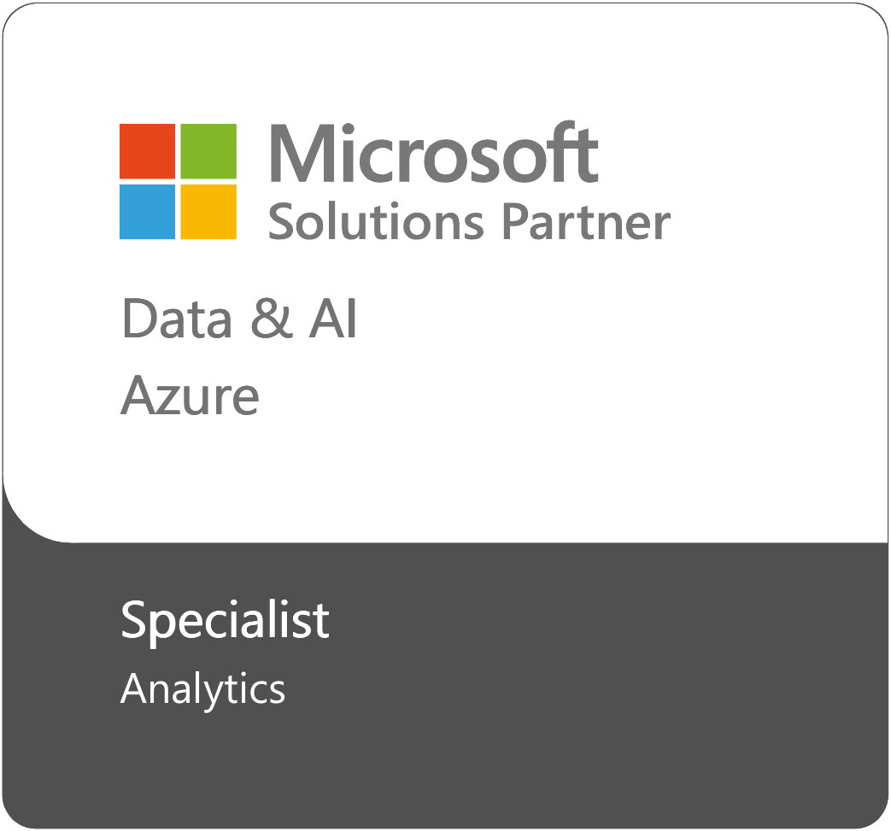
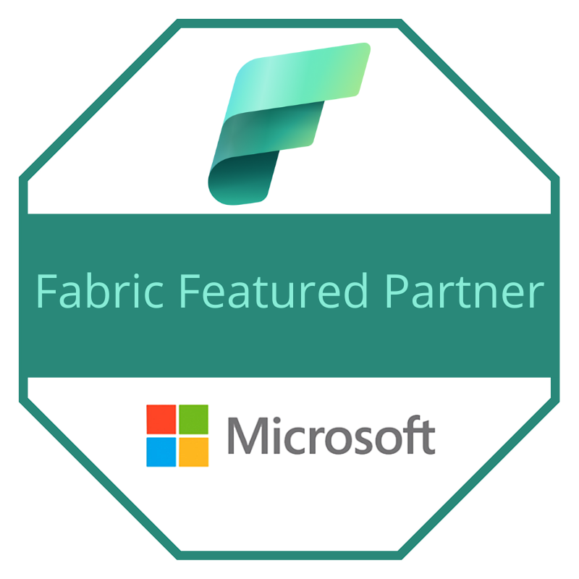
Meet the Speaker
Chris Hetzler
Solution Architect and Senior Manager at Eide Bailly, LLP
BS in Computer Science – NDSU 2003
MS in Software Engineering – NDSU 2005
MS in Data Science – UW 2023
24 Microsoft Certifications, including DP-600 and DP-700
17 years at Microsoft prior to joining Eide Bailly in 2022
SDE, CSA, TSP, SDE/T, PM
Dynamics, Power Platform, and Azure
LinkedIn - https://www.linkedin.com/in/thehetz/
Blog – https://www.thehetz.com/blog
Edie Bailly – https://www.eidebailly.com/microsoft
Notes:
We will kick off the session by welcoming attendees and introducing the speaker. We'll outline the session objectives and what participants can expect to learn during this presentation.

Slide 5
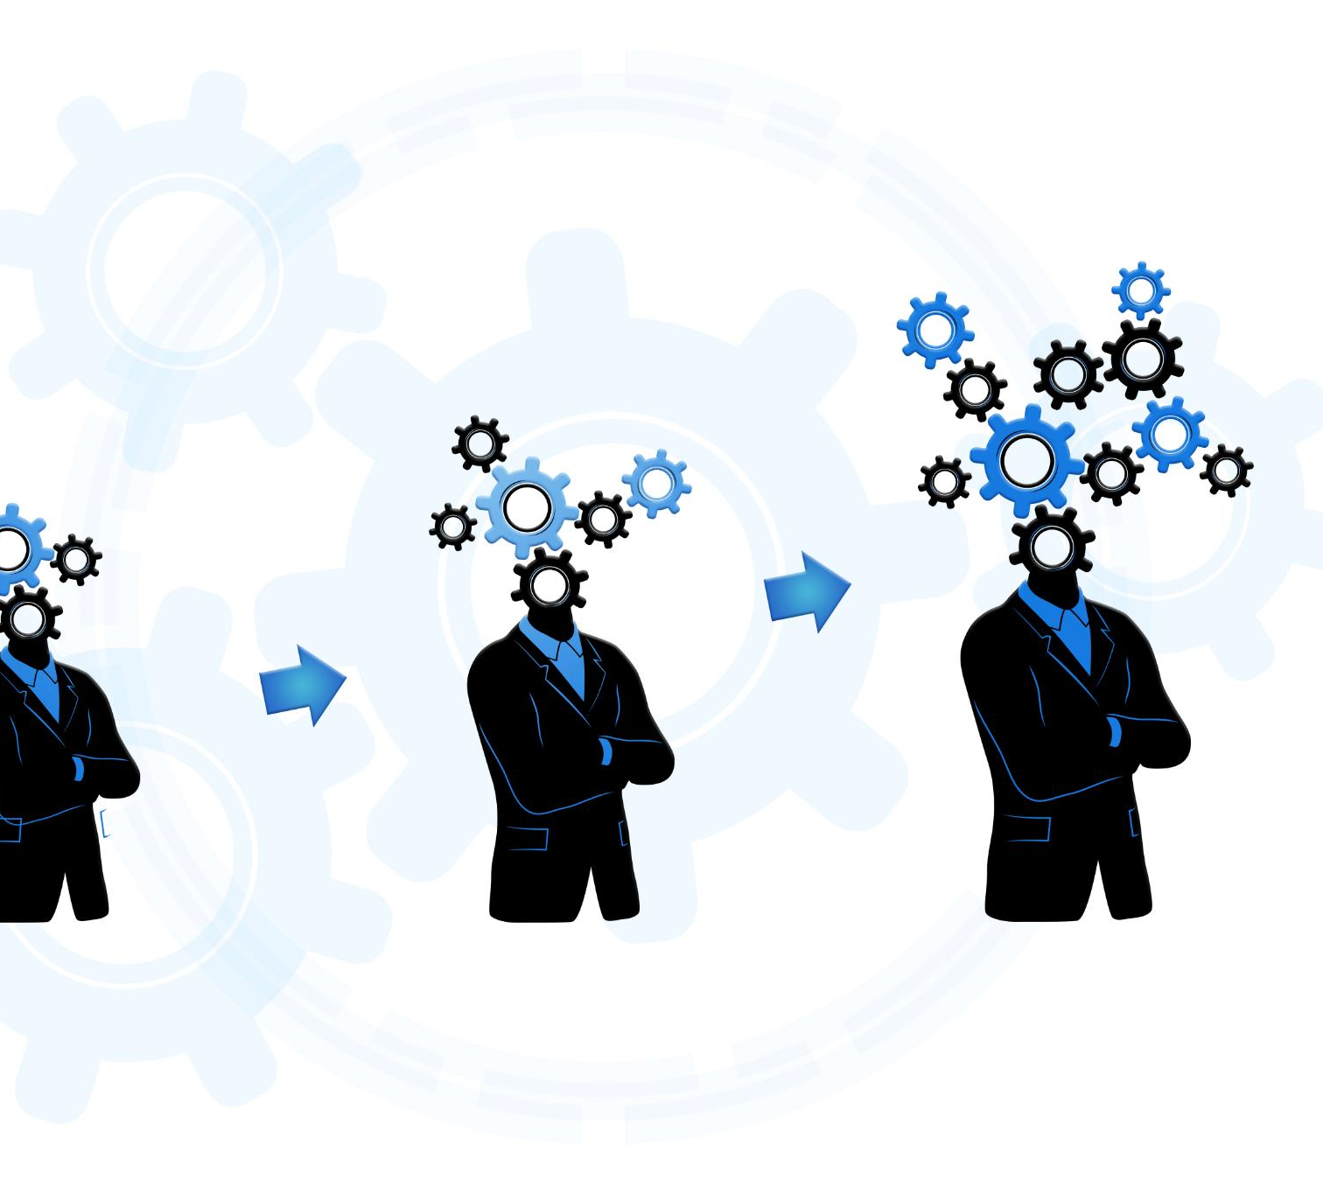
Session Agenda
Background Overview
A review of the client's original setup will provide necessary context.
Planning Phase / POC
Discuss the strategies and plans laid out before the migration process.
Q&A Session
We will conclude with a Q&A session to address any questions.
Notes:
Today's session will begin with an introduction, followed by a background overview of the client's original setup. We will discuss the planning phase, the migration process itself, challenges and solutions faced during the journey, post-migration activities, and conclude with a Q&A session.

Slide 6
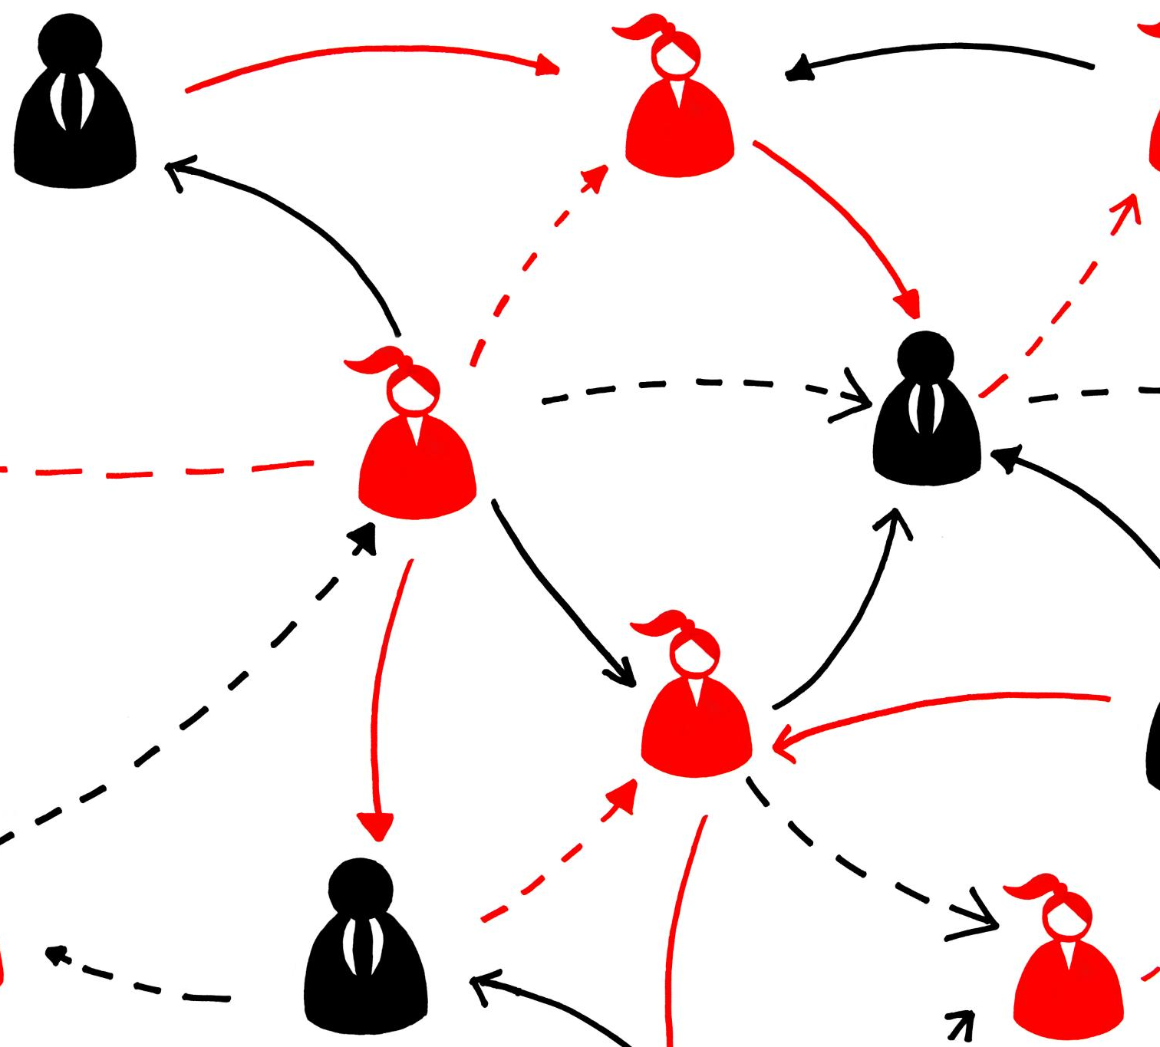
Overview of Session Objectives
Understanding Migration Process
Gain insights into the essential steps of the migration process for effective transitions.
Identifying Challenges
Learn to recognize potential challenges and obstacles during the migration process.
Exploring Solutions
Discover various solutions that can help mitigate challenges faced during migration.
Best Practices Learning
Understand best practices to ensure smooth transitions in your organization.
Notes:
The objectives of this session include understanding the migration process, identifying challenges and solutions, and learning best practices that can be applied to similar transitions in your organization.

Slide 7

Who is the Client?
International Hotel Chain
Many brands and little integration between the organizations
Data feeds daily or even real time
Data warehouse leveraged for more than analytics

Slide 8
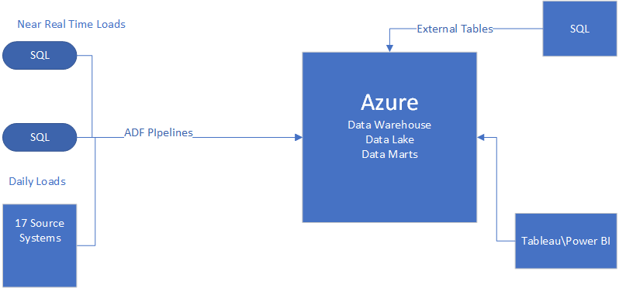
Client's Original Setup
Initial Architecture Overview
The client initially set up their data warehouse using Azure Data Factory and Azure SQL. This setup was foundational for their data management. This design came at a cost to performance for external systems and analysis.
Significance of Original Setup
Understanding the client's original architecture is crucial for evaluating the migration strategy. This insight informs decision-making during the POC and go-live transition.
Notes:
Here we will provide a brief overview of the client's initial data warehouse setup using Azure Data Factory and Azure SQL. Understanding the original architecture is critical to appreciate the rationale behind the migration.

Slide 9

Reasons for Migration to Fabric
Cost Efficacy and ROI
Currently ~$8000 in monthly Azure spend, due to intense ADF pipelines, Azure SQL scale requirements, and rapid data growth.
Scalability
Fabric allows for increased capacity to manage growing data needs effectively, separately from the processing needs.
Performance Improvements
Enhanced processing speeds lead to more efficient data operations and quicker insights. Over a 100% performance increase has been noted for the most intensive pipelines.
Enhanced Data Management / Collaboration
Improved tools for data organization and accessibility streamline operations significantly. Enhanced cross group collaboration by bringing data engineers and analysts into the same workspace.
Notes:
We will explore the key reasons driving the client's decision to migrate to a Fabric Data Warehouse and Fabric Pipelines. These reasons include scalability, performance improvements, and enhanced data management capabilities.

Slide 10

Initial Assessment and Requirements
Importance of Assessment
Conducting an initial assessment is vital for a successful migration.
Identifying Pain Points
The assessment helps uncover existing pain points in the current setup. Cost, Communication, Downtime, Performance, and maintenance.
Identifying Stakeholders
The assessment helps uncover the key stakeholders and team members. Security, Engineering, and Data Architecture teams were siloed and did not communicate.
Notes:
Before the migration, an initial assessment was conducted to gather requirements. This step was crucial in identifying the features needed in the new setup and understanding the existing pain points.

Slide 11

Key Considerations and Challenges
Technical Challenges
Identifying and resolving technical hurdles is crucial for a successful migration. Fabric is a new technology, so applying your team members’ existing knowledge is critical for success.
Organizational Change and Coordination
Managing organizational change is essential for team alignment. Training and support are necessary for smooth transitions. In a global organization, there are many challenges to change. Communication between Data Engineering, Security, and Infrastructure teams is critical.
Notes:
In this slide, we will discuss the key considerations identified during the planning phase, including technical and organizational challenges that needed to be addressed for a successful migration.

Slide 12
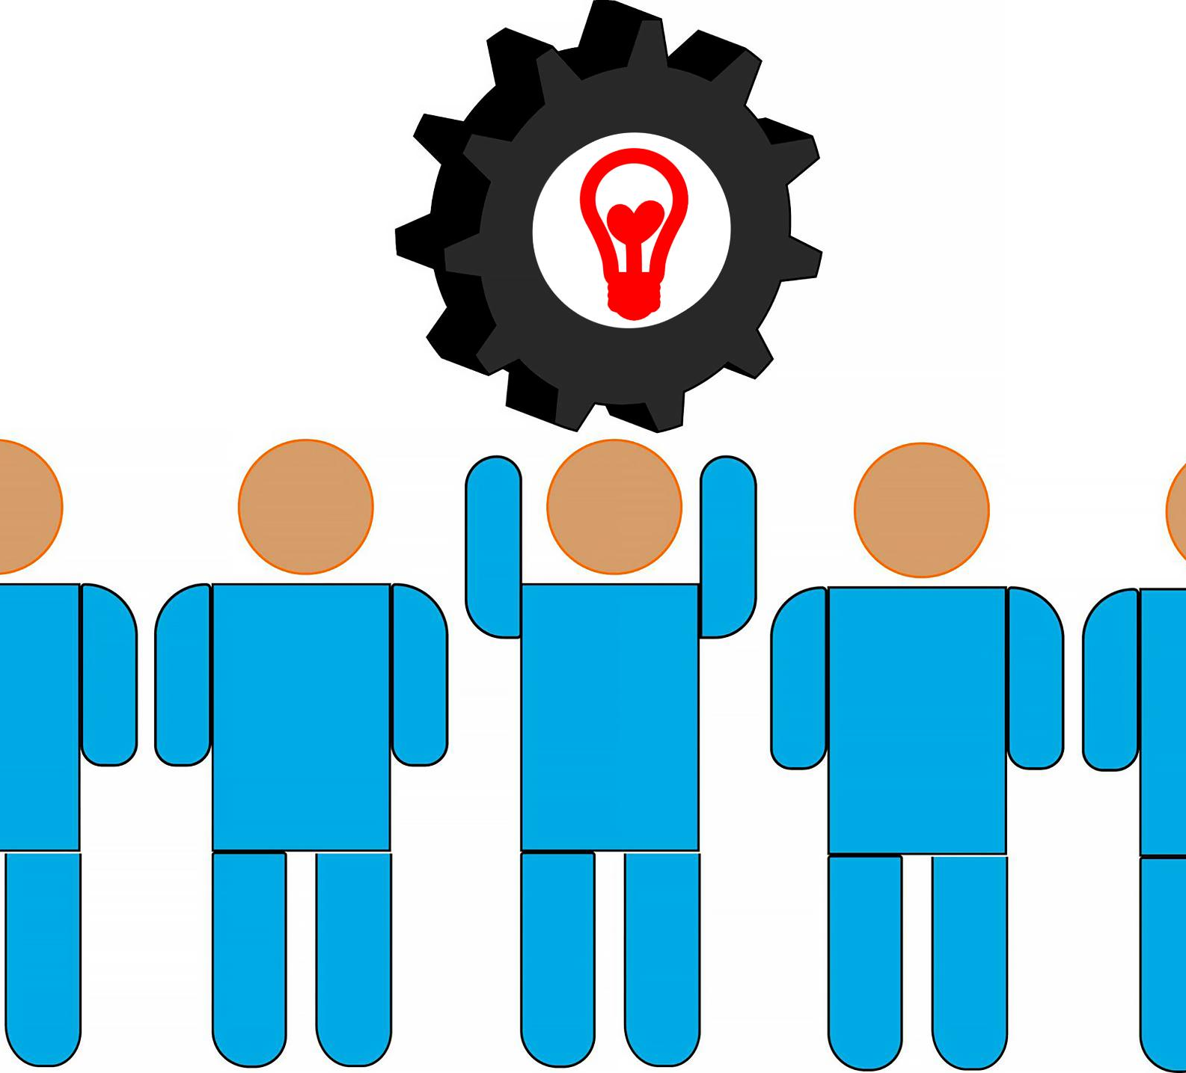
Developing Migration Strategy
Comprehensive Migration Strategy
A well-defined strategy ensures an effective transition during migration processes. In this case, our strategy has evolved over time and is considered a work in progress.
Constant Communication
Ensuring that all team members have an area of responsibility and are in communication regularly avoids surprises and bottlenecks. We hold weekly meetings, and the team meets in ad-hoc sessions in between the scheduled meetings. The team a scattered across the globe.
Stakeholder / End User Coordination
Engaging stakeholders is crucial for aligning goals and ensuring smooth execution. During the POC, analysists were regularly invited to run their queries against the Fabric POC and evaluate the results against the existing data warehouse.
Notes:
We developed a comprehensive migration strategy and timeline to ensure a smooth transition. This involved detailed project planning and coordination among various stakeholders.

Slide 13

Our Migration Steps
POC Phase
A POC was developed based on the fastest growing tables in Azure SQL (which were driving their costs up). The ADF pipelines were recreated in Fabric pipelines. Data was staged in a Fabric Lakehouse, rather than in Azure SQL tables.
Highest ROI Identification
The team looked at the ADF pipelines which were the highest in monthly cost and started migrating those into Fabric pipelines first. These pipelines were typically the ones that resulted in the highest rates of growth within the Azure SQL warehouse.
Testing and Validation
As the data begins to populate the Fabric warehouse, end-users are invited to test their queries and dashboards against the Fabric endpoint. This results in immediate feedback to the team and aids in prioritization of ongoing work items.
Notes:
In this section, we will outline the detailed steps taken during the migration process. This includes the sequential activities performed and the methodologies adopted for effective execution.

Slide 14
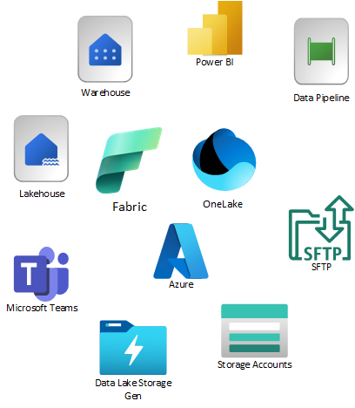
Tools and Technologies Used
Fabric Tools Overview
Data Pipelines, Workspaces, Power BI, Data Warehouse w/ SQL Endpoint, Lakehouse, OneLake
Azure Services
Storage accounts for landing external systems’ data are still in play so the external systems did not have to alter their implementations. Some files are encrypted, and we are leveraging the existing Azure functions and processes for the decryption.
Impact of Migration Tools
The right combination of tools ensures a smooth transition with minimal disruptions. Proper planning is key to success i.e., understanding the differences between Data Pipelines and Data Flows. We have a goal to limit the use of notebooks to only those scenarios where a no-code solution is not available.
Notes:
An overview of the tools and technologies leveraged during the migration process will be presented. This includes both Azure-specific tools and third-party solutions that facilitated a smooth transition.

Slide 15
Ensuring Data Consistency
Validation Strategies
Continuous validation from end users
Comparisons with existing data validation queries used in Azure SQL
Robust logging during key stages of data transformation within the pipelines
Validation of the logs after each run
Consistency Throughout Process
Common naming conventions allow various team members to understand which pipelines are moving which pieces of data.
Repositories for source control
Emails sent when errors or exceptions occur
Notes:
During migration, it is vital to ensure data integrity and consistency. We will cover the strategies in place to validate data throughout the process.

Slide 16

Common Challenges Encountered
Lossy Type Transformations
When staging was occurring within the Fabric warehouse, type information for the columns was being lost (all columns were auto created as strings).
Downtime
Their strategy allows for near-zero downtime, while also managing costs effectively. As ADF pipelines are turned off, end-users are migrated to the Fabric warehouse endpoint.
Compatibility Issues
The client is a heavy user of Tableau as well as Power BI. This created a small challenge for the team to overcome. The solution was to leverage the SQL endpoint exposed by the Fabric warehouse and provide the Tableau users with that connection string.
Security
The existing ADF pipelines manage all connection credentials in Azure Key Vault. All Azure storage accounts leverage Vnets and private endpoints for secure communications.
Notes:
This slide will address the common challenges faced during the migration, such as data loss, downtime, and compatibility issues. Identifying these challenges helps in preparing for a successful migration.

Slide 17
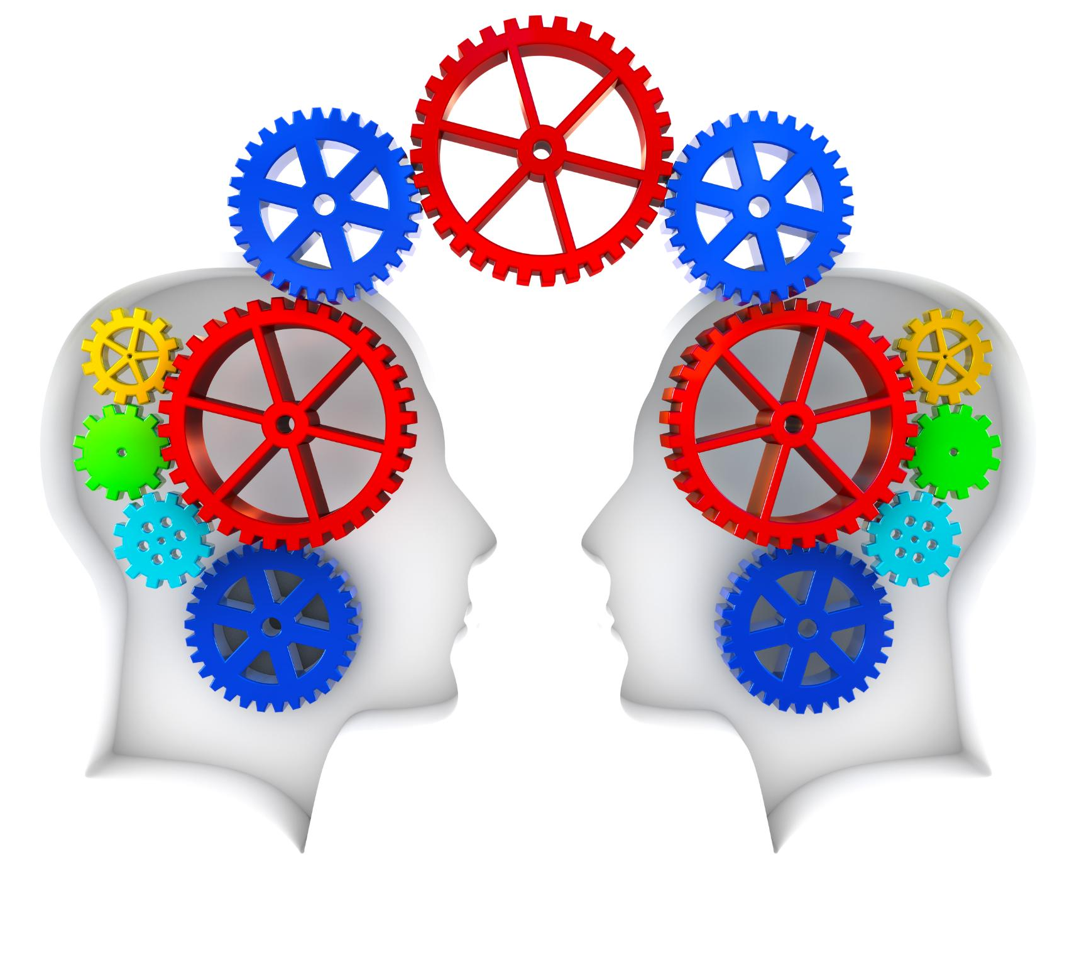
Solutions and Workarounds
Security
Until Key Vault was not supported within Fabric, so connections were simply created and an exception to the corporate policy was granted for this project, due to its critical nature.
Fabric identities are leveraged for all AuthN and AuthZ communication with Azure Storage. Privet Endpoints were also leveraged, prior to Fabric Identities’ availability.
Type Information Loss
Leveraging the Lakehouse for staging eliminated this issue and provides a central repository for all logging data within a semi-structured store.
Notes:
We faced several challenges during the migration process; here, we will present the solutions and workarounds implemented to overcome these obstacles, ensuring minimal disruption.

Slide 18

Lessons Learned
Successes of Migration
POC was critical to empower a skeptical team and leadership on the possibilities and benefits of Fabric.
Areas for Improvement
Key Vault, Source Control, Team Collaboration, Project management
Future Application of Lessons
Better coordination within the team and with external consumers. Team is rapidly up-skilling on Fabric.
Notes:
We will share key lessons learned from the migration project, including insights into what worked well and what could be improved. This information is invaluable for future migrations.

Slide 19

Session Conclusion
Recap Key Points
Iteration works, starting with a POC and utilizing knowledge transfer along the way.
Finding a knowledgeable partner who wants to advise and not take over.
Planning Significance
Plan your iterations and slowly migrate to a new technology, validating at each iteration with end consumers.
Execution Excellence
Effective execution is essential to ensure smooth transitions during the migration process. Continuous process Improvement.
Notes:
In conclusion, we will recap the key points discussed in today's session and reinforce the importance of thorough planning and execution in data warehouse migrations.

Slide 20
Q&A Session
Questions?
Clarifications?
Shared Experiences?
Notes:
Now we will open the floor for questions from the audience. This is your opportunity to seek clarification or share your own experiences related to data warehouse migrations.

Slide 21





Get Involved
in the Fabric
Community
aka.ms/FabricCommunity Connect with community members, ask questions, and learn more about Fabric
aka.ms/FabricUserGroups
Find a user group that matches your interests in your area or online
aka.ms/SuperUsers
Spread your Fabric knowledge, insights, and best practices with others
aka.ms/MVP Technology experts that share their knowledge and passion with the community

Slide 22

DP-700 Offer
Fast-track your career in data and AI
Become a Microsoft Certified Fabric Data Engineer Associate – take Exam DP-700 for free!
Visit the Fabric Community Lounge to learn more about this limited-time offer.
aka.ms/fabcon/dp700

Slide 23
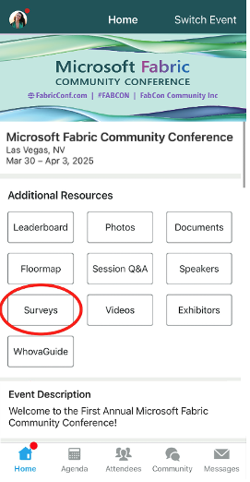
Session Feedback Surveys
We really want to hear from YOU!
In the pursuit of making next year’s Microsoft Fabric Community Conference even better, we want to hear your feedback about this session.
Here’s How -
Simply go to the Whova App on your smartphone
Scroll down on the Microsoft Fabric Community Conference Homepage to ‘Additional Resources’ to click “Surveys’.
Click Session Feedback.
Scroll down to find this session title.
Complete the session feedback survey.
Finally, click ‘Submit’
It’s just that easy!

Slide 24
